Slide 1
Vendor Remote Access Management
Paul Hopson
Compliance Team Lead
June 6, 2024

Slide 2
Purpose of CIP-005-7 R3
Ensure that Electronic Access Control or Monitoring Systems (EACMS) and Physical Access Control Systems (PACS) are not vulnerable to some of the threats introduced by having vendors and suppliers manage and/or support your assets remotely

Slide 3
Vendor Remote Access Management for EACMS and PACS

Slide 4
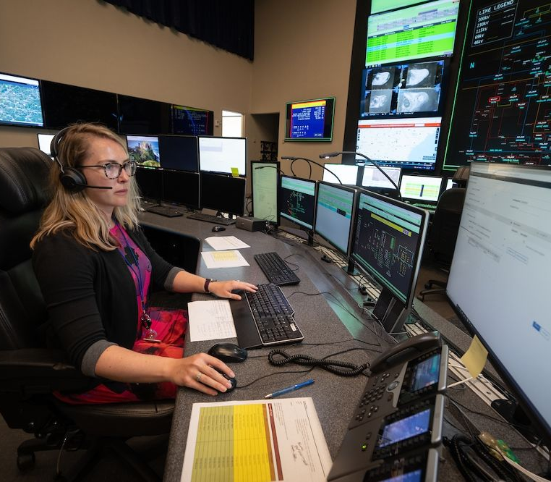
Vendor Remote Access Risk
Your BES Cyber Assets (BCAs) and Protected Cyber Assets (PCAs) probably have more cybersecurity controls deployed around them than the network that is hosting your laptop or desktops. When a remote connection is established, the less secured remote device now introduces foreign threats to the environment.
Remote access by a vendor further elevates this risk because you are not in control or knowledgeable of how strong their security posture is. Just by allowing a remote connection from a vendor, your organization has assumed a certain level of risk.

Slide 5
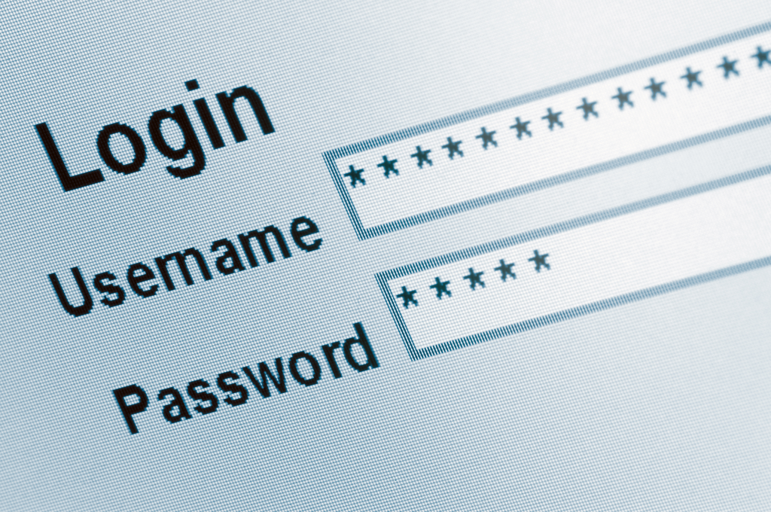
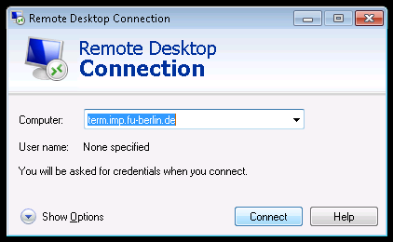
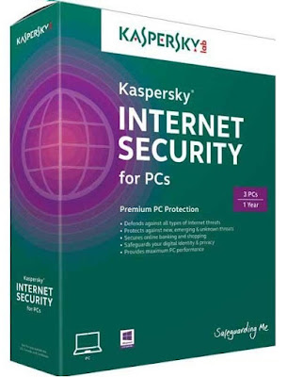
Some Things to Consider
How well do you trust the vendor’s cybersecurity posture at their facility?
Are you comfortable that the tools they use have been secured appropriately to the level of criticality of your environment?
Do you trust the actions they are performing within the environment? Can you validate that work?
How do you know their login ID has not been compromised?

Slide 6
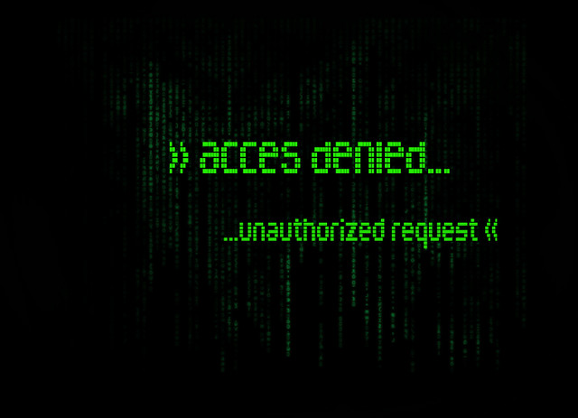
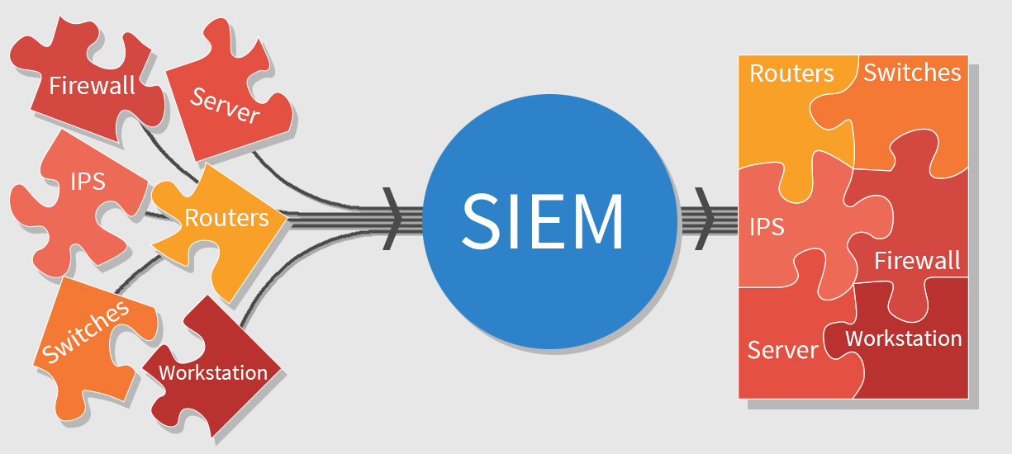
What You Can Do to Meet Compliance Objectives
Zero Trust: Deny-by-Default
Control Each Connection
Ensure You Are Logging and Auditing
Isolate Your Supply Chain

Slide 7
Contact Info
Paul Hopson
Compliance Team Lead
Paul.Hopson@texasre.org
512-583-4972

Slide 8
Questions?

