Slide 1
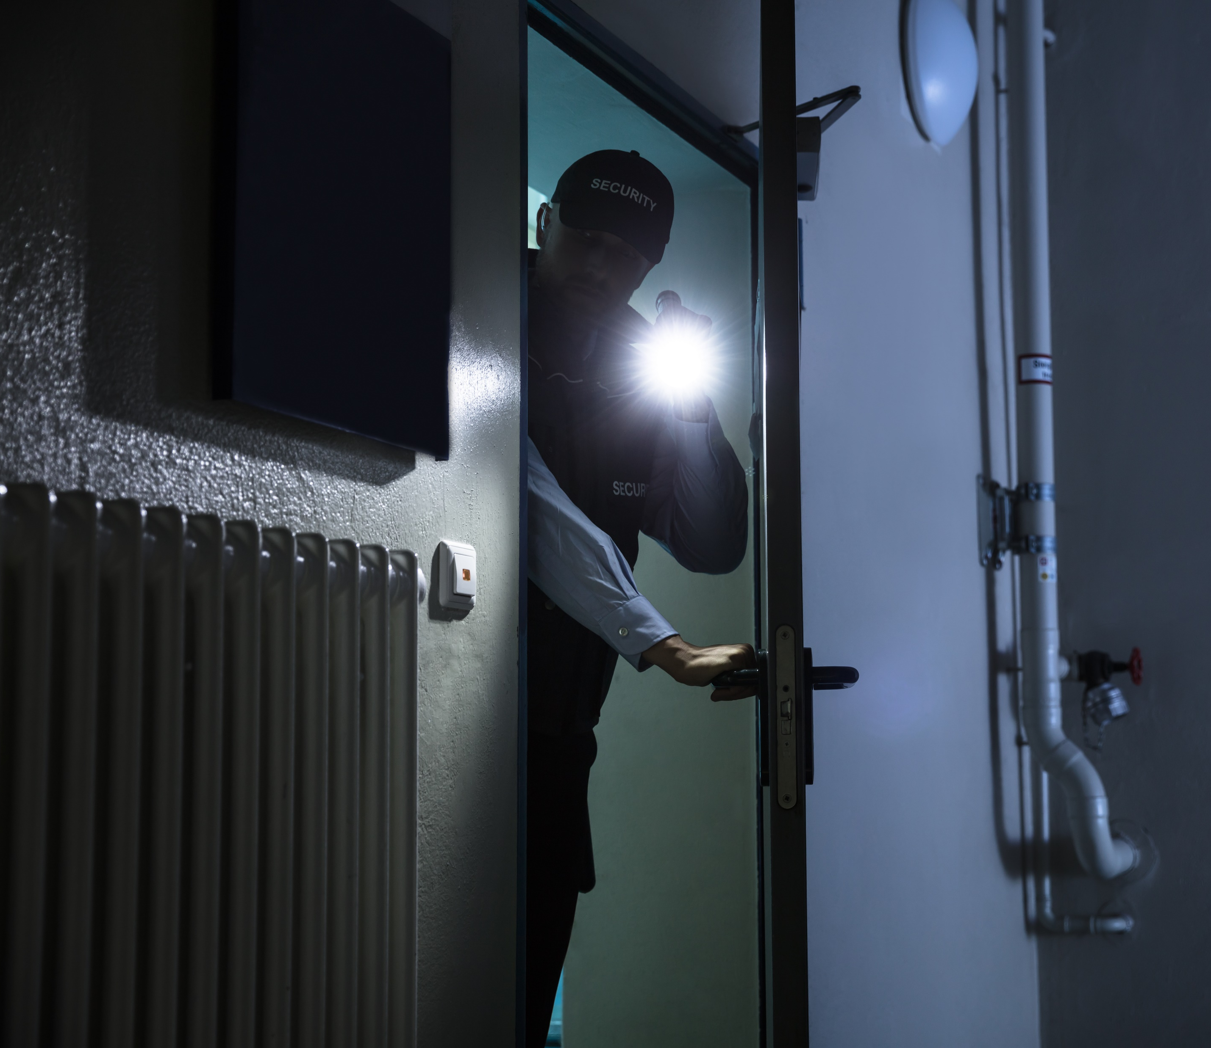
CIP Physical Security Walkthroughs
Paul Hopson
Compliance Team Lead
May 3, 2024

Slide 2
Understanding CIP Physical Security Walkthroughs
Physical security walkthroughs involve reviewing the physical security of BES Cyber Systems (BCS) to assess the effectiveness of physical security plans, visitor control programs, Physical Access Control Systems (PACS), and to ensure compliance with NERC CIP standards
These walkthroughs seek to identify any vulnerabilities or deficiencies and ensure they are addressed to mitigate the risk of unauthorized access or other security threats to critical infrastructure

Slide 3
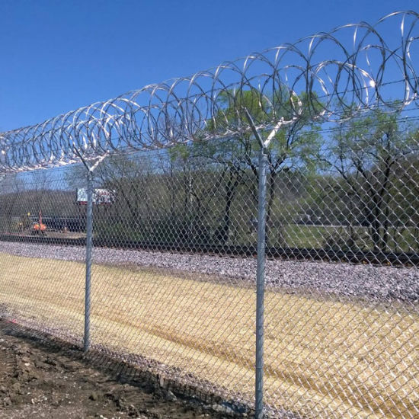
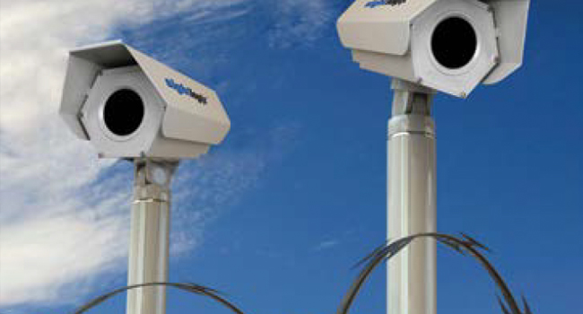
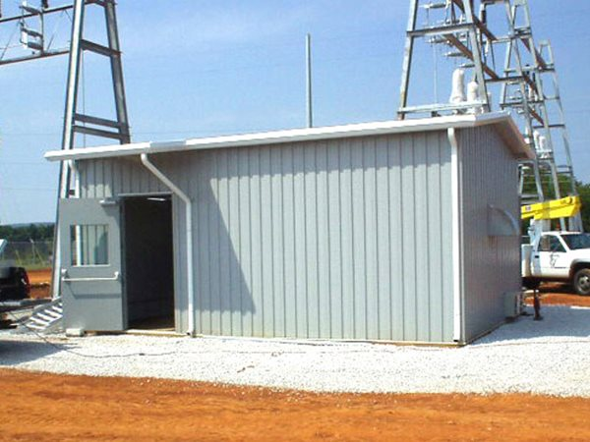
Some Key Components of a CIP Physical Security Walkthrough
Access Controls
Perimeter Security
Intrusion Detection
Surveillance
Security Personnel
Access Logs

Slide 4
CIP Standards Used During Walkthroughs
CIP-003-8 (Low Impact BCS)
Section 2, Physical Security Controls – at the asset or the locations of the low impact BES Cyber Systems within the asset, and the Cyber Assets that provide electronic access controls

Slide 5
CIP Standards Used During Walkthroughs
CIP-006-6 (High and Medium Impact BCS with External Routable Connectivity)
Part 1.2 Utilize at least one physical access control to allow only individuals who have authorized unescorted physical access into the Physical Security Perimeter (PSP)
Part 1.3 Utilize at least two or more different physical access controls
Part 1.4 Monitor for unauthorized access into a PSP
Part 1.5 Issue an alarm or alert in response to detected unauthorized access through a physical access point to the personnel identified in the BES Cyber Security Incident response plan within 15 minutes of detection
Part 1.6 Monitor each Physical Access Control System (PACS) for unauthorized physical access
Part 1.7 Issue an alarm or alert of detected unauthorized physical access to a PACS to personnel identified in the BES Cyber Security Incident response plan within 15 minutes of detection
Part 1.8 Log entry of everyone with authorized unescorted physical access into each PSP
Part 1.9 Retain physical access logs for at least 90 days
Part 1.10 Restrict physical access to cabling and nonprogrammable communication components outside of the PSP, or encrypt/monitor the status of the link and issue alarm/alert within 15 minutes of detection, or equal logical protection
Part 2.2 Require manual or automated visitor logging
Part 2.3 Retain visitor logs for at least 90 days

Slide 6
CIP Standards Used During Walkthroughs
CIP-007-6
High Impact BCS and Medium Impact BCS at Control Centers and associated PCA and nonprogrammable communication components located inside both physical and electronic security perimeters
Part 1.2 Protect against the use of unnecessary physical input/output ports used for network connectivity, console commands, or removable media
Additional Information
CIP-014-3 – Physical Security – Reviewing evidence (applicability lists, models, and technical analyses) of the risk assessments
Electronic Access Points identified and associated PSPs
Physical Access Control Systems
Cyber Assets identified – sampled
TOP-001-6 R20 – Verify that there is redundant and diversely routed infrastructure (switches, routers, servers, power supplies, network cabling, etc.) at the primary Control Center, including its associated data center
Electronic Access Controls & Monitoring Systems (EACMS)

Slide 7
CIP Physical Walkthroughs during Your Engagement
Inspect perimeter fencing, gates, and barriers to ensure they are adequate to deter unauthorized access
Check surveillance systems, including cameras and sensors, to verify their functionality and coverage
Test access control measures, such as card readers, alarms/alerts, and security personnel to ensure only authorized individuals can enter secure areas
Review access logs, and visitor logs to ensure continuous escorted access of visitors within the PSP
Review environmental controls for Control Centers and associated datacenters, redundancy and diverse routing - avoiding single points of failure

Slide 8
Questions?

